Slide 1
Introduction to Mongodb

Slide 2
Introduction
MongoDB is an open-source document database, and leading NoSQL database.
MongoDB is written in c++.
MongoDB is a cross-platform, document oriented database that provides, high performance, high availability, and easy scalability.
MongoDB works on concept of database,collection and document.

Slide 3
Advantages of Mongodb over rdbms
Schema less : MongoDB is document oriented database in which one collection holds different different documents. Number of fields, content and size of the document can be differ from one document to another.
Structure of a single object is clear
No complex joins
Deep query-ability. MongoDB supports dynamic queries on documents using a document-based query language that's nearly as powerful as SQL
Tuning
Ease of scale-out: MongoDB is easy to scale
. Conversion / mapping of application objects to database objects not needed (No ORM)
In memory mapping

Slide 4
Where should not mongodb used?
Systems that require joins and ACID properties

Slide 5
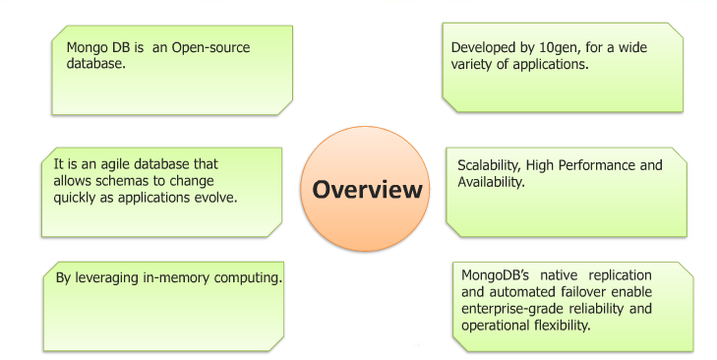
Mongodb overview

Slide 6
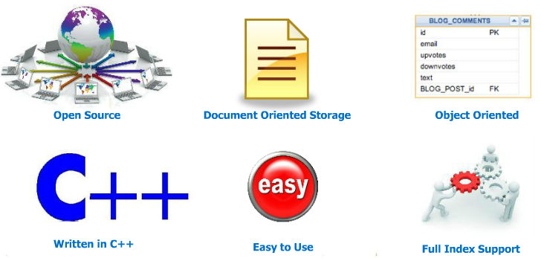
What is mongodb?

Slide 7
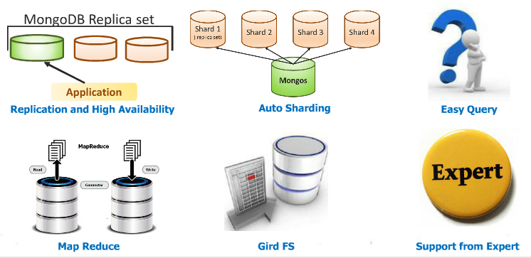
What is Mongodb?

Slide 8
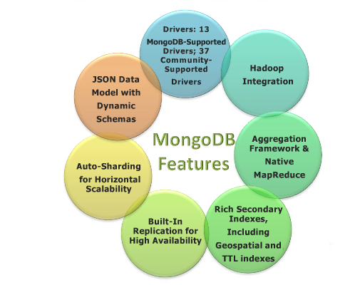
Mongodb features

Slide 9
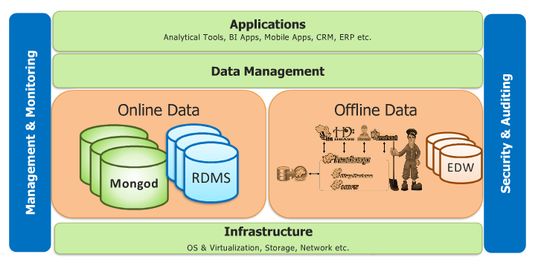
MongoDB architecture

Slide 10
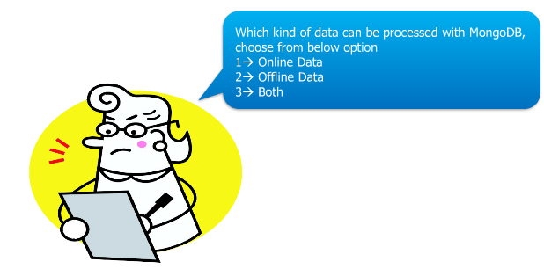

Slide 11


Slide 12
Mongodb Licensing
Free software foundation
Mongodb
Commercial Licenses
Mongodb enterprises

Slide 13
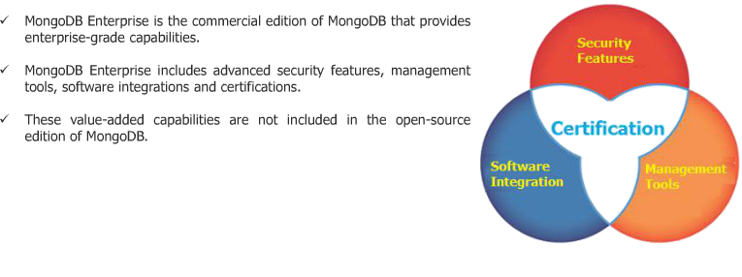
Mongodb enterprises

Slide 14
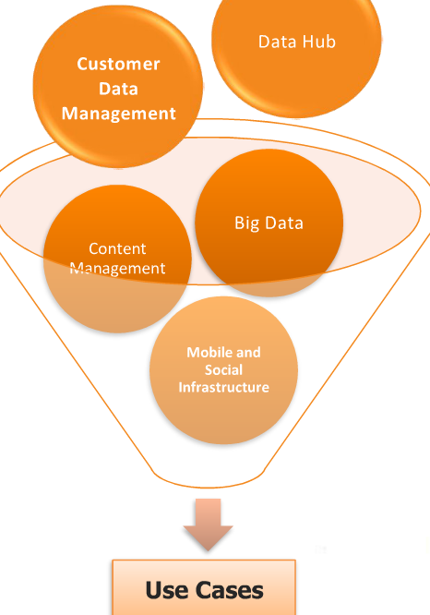
Different usecases

Slide 15
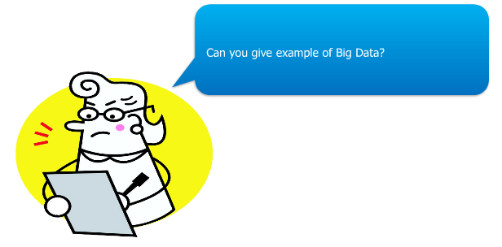

Slide 16


Slide 17
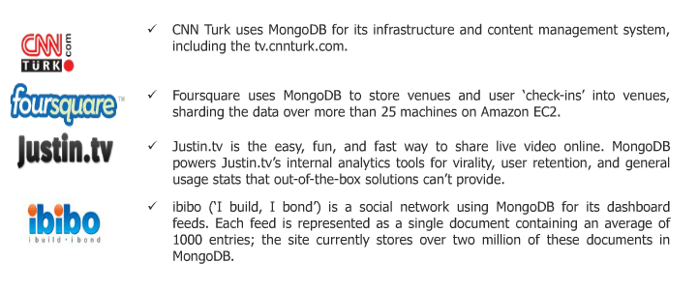
Mongodb clients

Slide 18
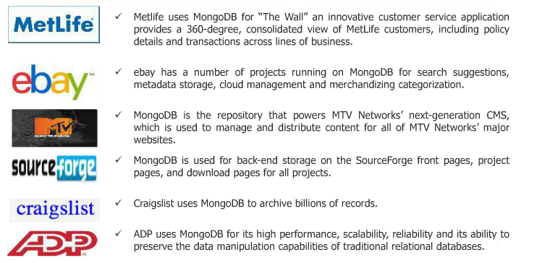
Mongodb clients

Slide 19

Financial services

Slide 20

Healthcare services

Slide 21

Government

Slide 22
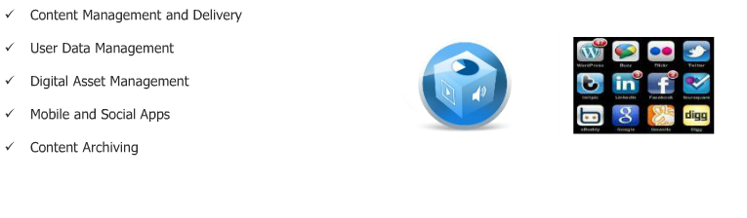
Media and entertainment

Slide 23
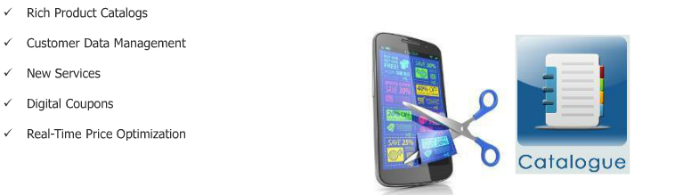
Retail

Slide 24
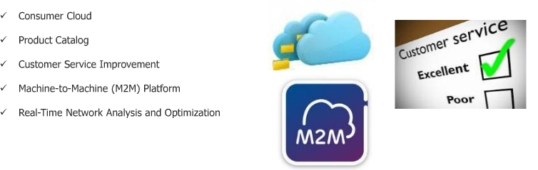
Telecommunication

Slide 25
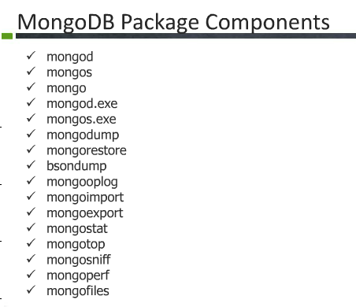

Slide 26
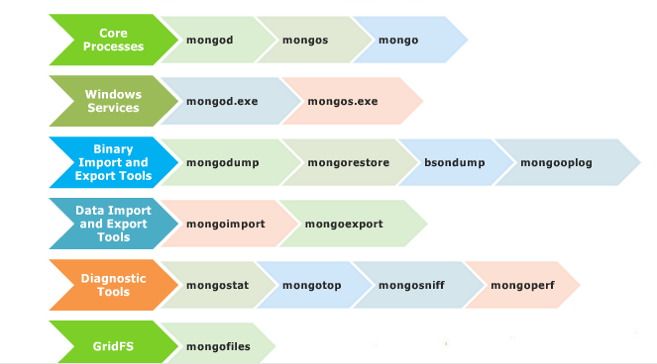
Mongodb package component tools

Slide 27
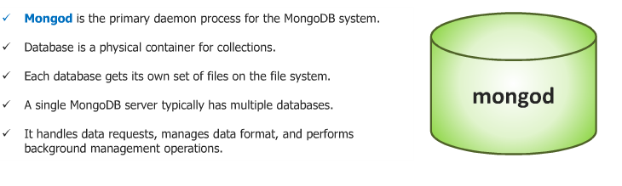
Mongod

Slide 28
Mongo and Mongos
Mongo is a JavaScript shell that acts like a client and connnect to mongod or mongos for general database operation.
Mongod is the database.
Mongos is the daemon which acts as the query router between the client (mongo/application layer) and the sharded cluster.

Slide 29
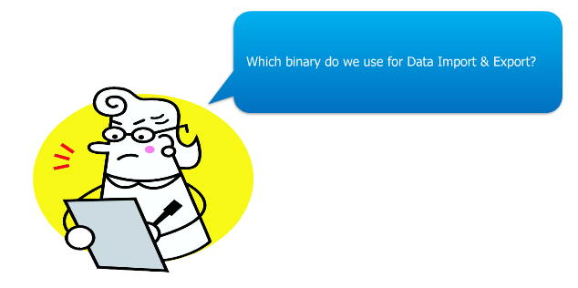

Slide 30
Mongoimport and mongoexport

Slide 31
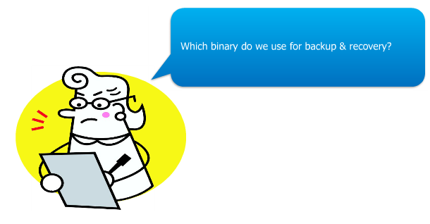

Slide 32
Mongodump and mongorestore

Slide 33
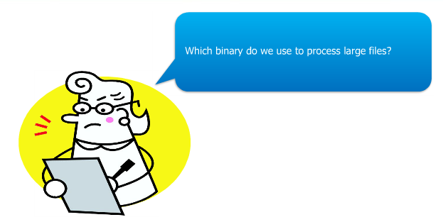

Slide 34
mongofiles

Slide 35
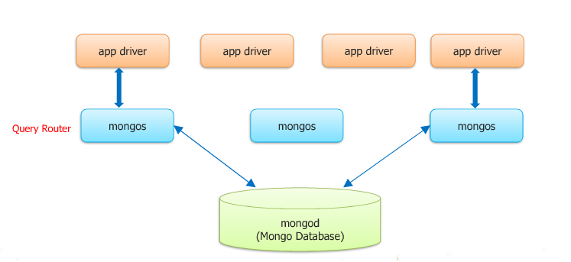
Mongodb development environment

Slide 36
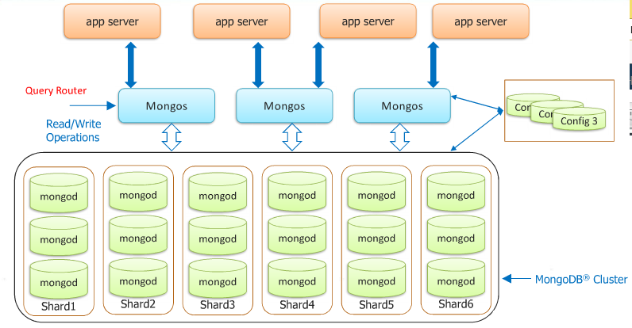

Slide 37
The process
Appdriver or the monlient sends a query to the mongos.
Mongos inturn checks the data in the configdb.
Mongos is the interface.
Configdb is something that contains the metadata of the mongod. It is actually another mongod.
Whatever data stored in mongod is also stored in the configdb.
Mongos when fires the query ,it consults the configuration database looking for the set of data, in which mongod it sets to go and get the metadata information and fire the query for.
We can have multiple mongods in a cluster.
One cluster can have different shards. One shard can have multiple mongods.

Slide 38
Example
Suppose we have 1 TB of data distributed in 10 shards each of 100 GBs.
Configdb knows that 1-100gbs resides in shard1 and ,101-200gbs resides in shard2 and ,201-300gbs in shard3 and so on…..
When mongos fires the query after getting it from the mongo, the configdb tells in which mongod your data is and the query fires inthat mongod.
It doesnot have to search all the shards.

Slide 39
Database,collection and Document
Database
Database is a physical container for collections. Each database gets its own set of files on the file system. A single MongoDB server typically has multiple databases.
Collection
Collection is a group of MongoDB documents. It is the equivalent of an RDBMS table. A collection exists within a single database. Collections do not enforce a schema. Documents within a collection can have different fields. Typically, all documents in a collection are of similar or related purpose.
Document
A document is a set of key-value pairs. Documents have dynamic schema. Dynamic schema means that documents in the same collection do not need to have the same set of fields or structure, and common fields in a collection's documents may hold different types of data.

Slide 40
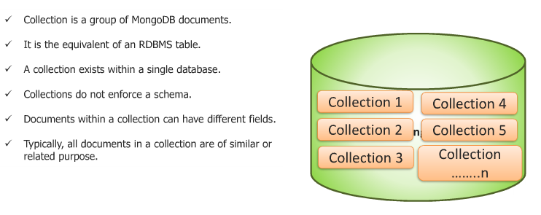
Mongodb collection

Slide 41
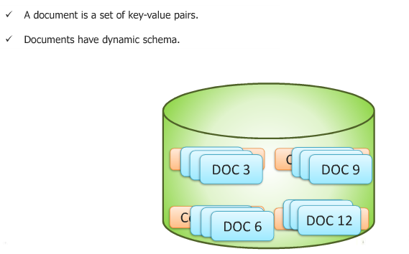
Mongodb Document

Slide 42
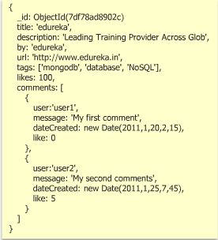
Mongodb Sample Document

Slide 43
_id
_id is a 12 bytes hexadecimal number which assures the uniqueness of every document.
You can provide _id while inserting the document.
If you didn't provide then MongoDB provide a unique id for every document.
The first 4 bytes for the current timestamp
next 3 bytes for machine id
next 2 bytes for process id of mongodb server
and remaining 3 bytes are simple incremental value.

Slide 44
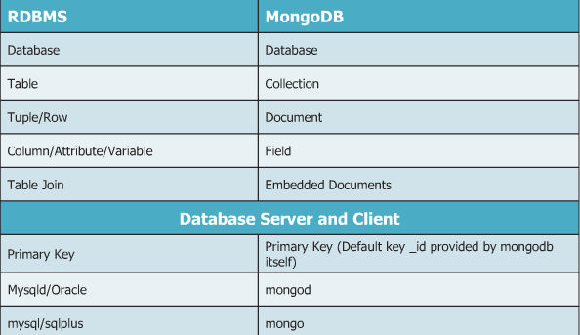

Slide 45
JSON
JSON stands for JavaScript Object Notation
JSON is a lightweight data-interchange format
JSON is language independent *
JSON is "self-describing" and easy to understand
JSON example:
{"employees":[ {"firstName":"John", "lastName":"Doe"}, {"firstName":"Anna", "lastName":"Smith"}, {"firstName":"Peter", "lastName":"Jones"} ]}
The following XML example also defines an employees object with 3 employee records:
XML Example
<employees> <employee> <firstName>John</firstName> <lastName>Doe</lastName> </employee> <employee> <firstName>Anna</firstName> <lastName>Smith</lastName> </employee> <employee> <firstName>Peter</firstName> <lastName>Jones</lastName> </employee> </employees>

Slide 46
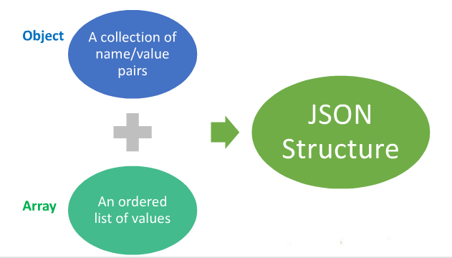
JSON

Slide 47
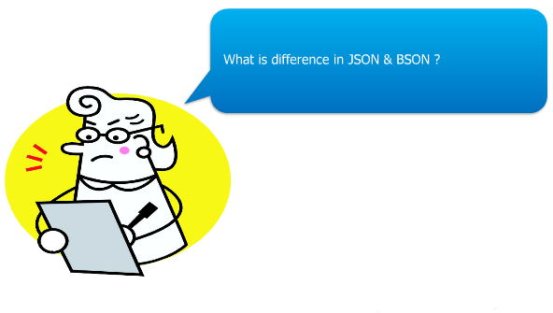

Slide 48
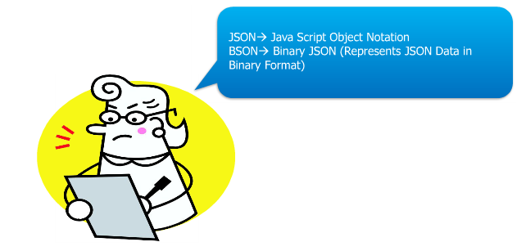

Slide 49
Mongodb Basics
1. MongoDB has the same concept of a database with which you are likely already familiar .Within a MongoDB instance you can have zero or more databases, each acting as high-level containers for everything else.
2. A database can have zero or more collections. A collection shares enough in common with a traditional table that you can safely think of the two as the same thing.
3. Collections are made up of zero or more documents. Again, a document can safely be thought of as a row.
4. A document is made up of one or more fields, which you can probably guess are a lot like columns.
5. Indexes in MongoDB function mostly like their RDBMS counterparts.
6. Cursors is something that when you ask MongoDB for data, it returns a pointer to the result set called a cursor, which we can do things to, such as counting or skipping ahead, before actually pulling down data.

Slide 50
Document store
RDBMS |  | MongoDB
Database |  | Database
Table, View |  | Collection
Row |  | Document (JSON, BSON)
Column |  | Field
Index |  | Index
Join |  | Embedded Document
Foreign Key |  | Reference
Partition |  | Shard
> db.user.findOne({age:39})
{
"_id" : ObjectId("5114e0bd42…"),
"first" : "John",
"last" : "Doe",
"age" : 39,
"interests" : [
"Reading",
"Mountain Biking ]
"favorites": {
"color": "Blue",
"sport": "Soccer"}
}
Notes:
Flexible schema
Javascript

Slide 51
CRUD
Create
db.collection.insert( <document> )
db.collection.save( <document> )
db.collection.update( <query>, <update>, { upsert: true } )
Read
db.collection.find( <query>, <projection> )
db.collection.findOne( <query>, <projection> )
Update
db.collection.update( <query>, <update>, <options> )
Delete
db.collection.remove( <query>, <justOne> )
Notes:
Create
The field name _id is reserved for use as a primary key; its value must be unique in the collection, is immutable, and may be of any type other than an array.
The field names cannot start with the $ character.
The field names cannot contain the . character.
Create with save
If the <document> argument does not contain the _id field or contains an _id field with a value not in the collection, the save() method performs an insert of the document.
Otherwise, the save() method performs an update.
sds

Slide 52
CRUD example
> db.user.insert({
first: "John",
last : "Doe",
age: 39
})
> db.user.find ()
{
"_id" : ObjectId("51…"),
"first" : "John",
"last" : "Doe",
"age" : 39
}
> db.user.update(
{"_id" : ObjectId("51…")},
{
$set: {
age: 40,
salary: 7000}
}
)
> db.user.remove({
"first": /^J/
})

Slide 53
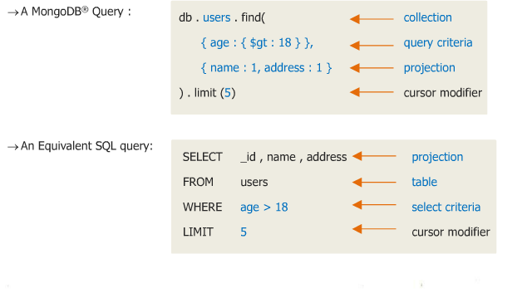
Querying

Slide 54
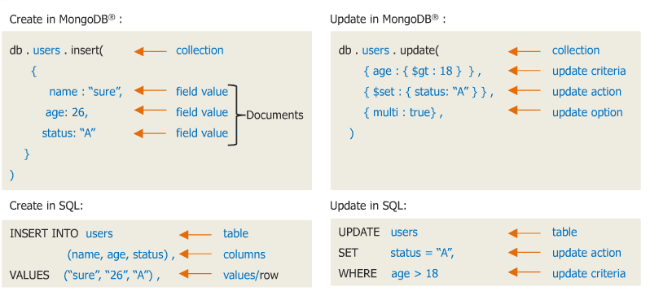

Slide 55
Create database
MongoDB use DATABASE_NAME is used to create database. The command will create a new database, if it doesn't exist otherwise it will return the existing database.
In mongodb default database is test. If you didn't create any database then collections will be stored in test database.

Slide 56
Syntax
Basic syntax of use DATABASE statement is as follows:
use DATABASE_NAME
Example:
If you want to create a database with name <mydb>, then use DATABASE statement would be as follows:
>use mydb
switched to db mydb
To check your currently selected database use the command db
>db mydb
If you want to check your databases list, then use the command show dbs.
>show dbs
local 0.78125GB
test 0.23012GB
Your created database (mydb) is not present in list. To display database you need to insert atleast one document into it. For which you need a collection.
after that when you type
>show dbs
local 0.78125GB
mydb 0.23012GB
test 0.23012GB

